Slide 1

Jukki.ro - an online store that offers a wide range of products for babies and their mothers.

Slide 2

Testing approach
Functional Testing:
User Registration, Login, and Account Management functionality;
Product Search functionality;
Shopping Cart functionality (adding, updating, removing items);
Checkout Process (payment method and order confirmation);
Cross-browser Compatibility (Chrome & Safari).
Non-Functional Testing:
Performance Testing.

Slide 3
Tools
TestLink
Mantis
BlazeMeter
JMeter
Asus ZenBook
iPhone 12

Slide 4
Testing types
Functional Testing:
Black-box Testing;
Exploratory Testing;
Smoke Testing;
Cross-browser compatibility;
Positive & Negative Testing.
Non-Functional Testing:
Performance Testing;

Slide 5
Test cases overview
183 Test Cases:
91 – Chrome;
88 – Safari;
4 – Performance.

Slide 6
Bugs overview
27 Bugs:
14 – Chrome;
13 – Safari.

Slide 7
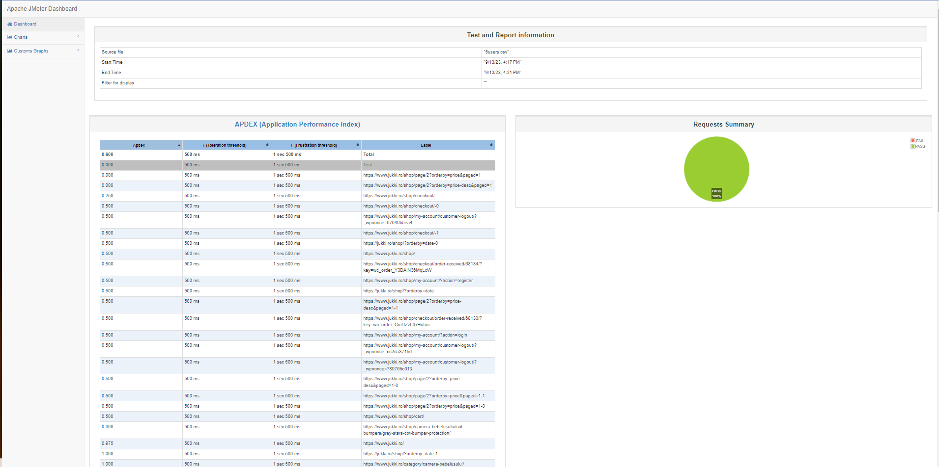
Performance Tests
Thread group: 5
Ramp-up period (seconds): 1
Loop Count: 1
Duration Assertion: 2000 miliseconds
Constant timer: 2000 miliseconds

Slide 8
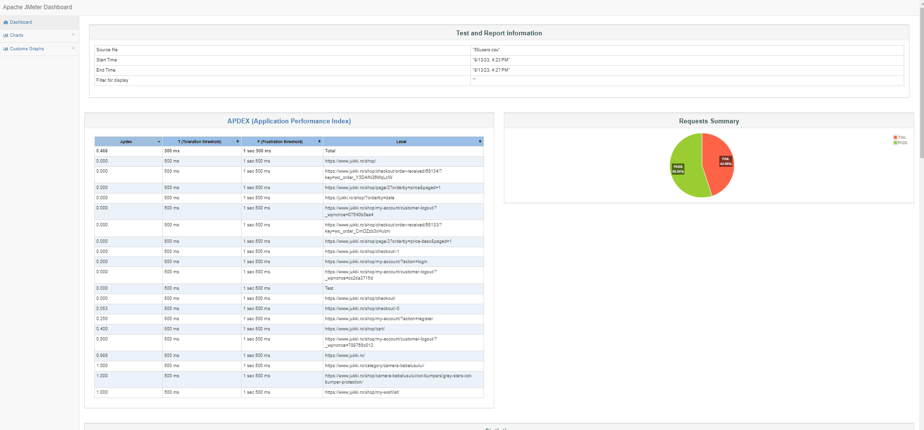
Performance Tests
Thread group: 50
Ramp-up period (seconds): 10
Loop Count: 1
Duration Assertion: 2000 miliseconds
Constant timer: 2000 miliseconds

Slide 9
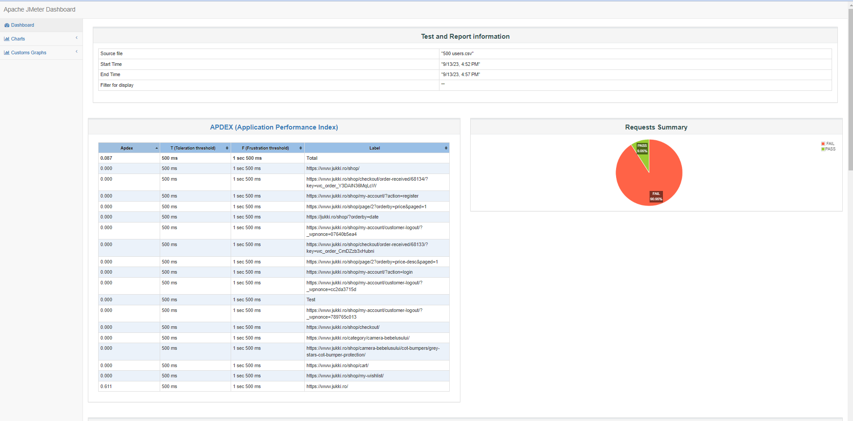
Performance Tests
Thread group: 500 Ramp-up period (seconds): 50 Loop Count: 1 Duration Assertion: 2000 miliseconds Constant timer: 2000 miliseconds

Slide 10
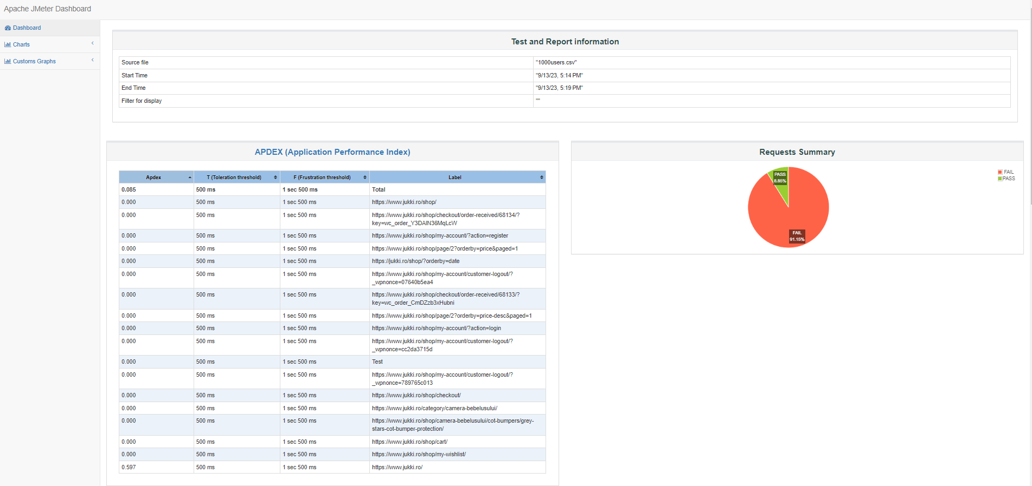
Performance Tests
Thread group: 1000 Ramp-up period (seconds): 50 Loop Count: 1 Duration Assertion: 2000 miliseconds Constant timer: 2000 miliseconds

Slide 11
Conclusions
The application currently lacks a maximum limit on the number of products a user can purchase in a single transaction, which poses a critical risk to the system’s functionality.
Also, it’s important to note that out of the four load tests conducted (5 users, 50 users, 500 users, 1000 users) only one test passed, indicating significant performance issues.

